Slide 1

BI-Project Customer Churn Analysis
Prepared by Vanessa CHARLES
email : vanessacharleshaiti@gmail.com
Phone : 44713802

Slide 2
Problem
Describe the business problem and define the analytic approach to solving the problem.
The problem of the telecom company is because of several rivals that are constantly trying to steal customers hence they lose their customers they automatically they lose money .
The stakeholders impacted by the problem are the company executives,the marketing team and the customer service team and the investors.
This is a huge problem for the company because losing customers is costly for any business, as it can directly affect the profitability of the company.

Slide 3
Methodology
We work on a file of 7000 customers in Kaggle,come from the Telcocompany. We use Jupyter notebook to do the analysis, first we import all the libraries needed and we start with Data preprocessing which makes the information cleaner and more suitable to work.
And we start with the data analysis, Through data analysis, we will be able to make decisions about customer trends and behaviors, which will allow us to make effective decisions

Slide 4
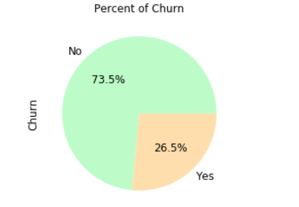
Impact of the Churn
The telecompany has had a total of 7043
customers in the past month but has lost about 1869 customers
(26.54%) any category combined and now the company
have 5174 customer (73.46%).

Slide 5
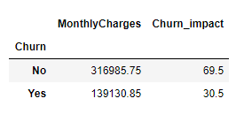
How much is churn affecting the company
Monthly the company lost 30.5% of the revenue.

Slide 6
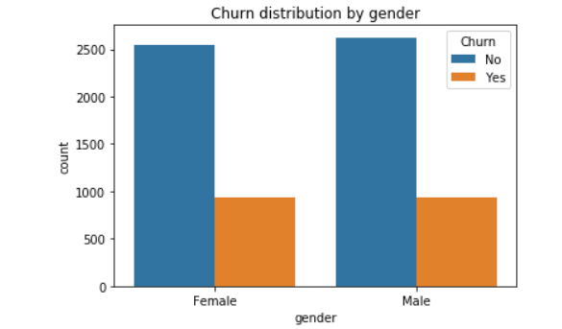
Customer demographics : Gender
From the plot, it looks like gender does not play a role in customer churn Almost as many
women as men have churned during the past
month.

Slide 7
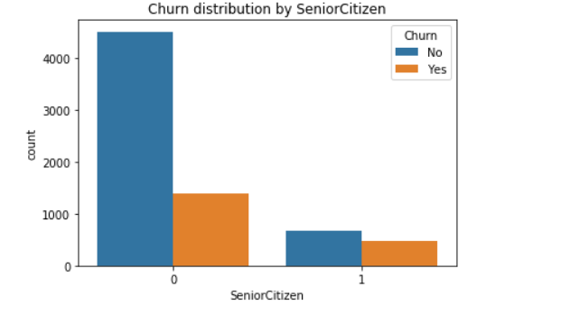
Customer demographics: Age
As we can see youngs customers churn less than
Seniors.

Slide 8
DISTRIBUTION OF CHURN BY
SERVICES

Slide 9
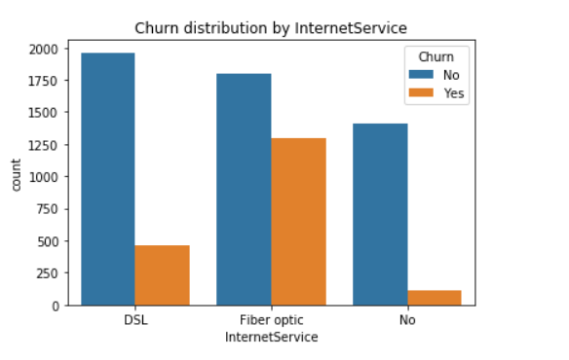
Service INTERNET
The chart above is interesting, because can help us to discriminate retained and churned customers, it shows that most customers that churned had the Fiber optic internet service, and the most customers that were retained had DSL internet service. Maybe the company should only provide DSL as the internet service or stop providing Fiber optics for it’s internet service.

Slide 10
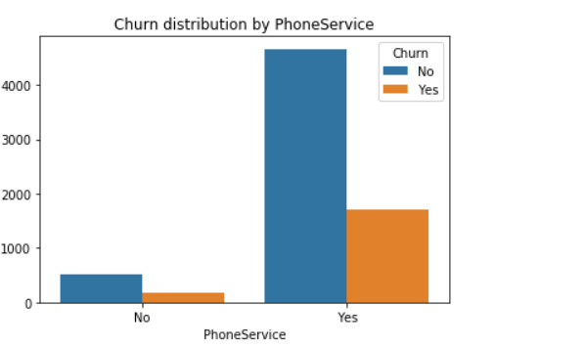
PhoneService Customers who use phone services churn less than customers who not use phone services.

Slide 11
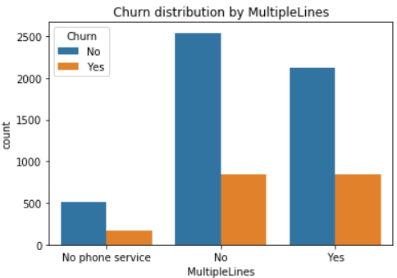
Service MultipleLines
Customers who not use phone service churn less .

Slide 12
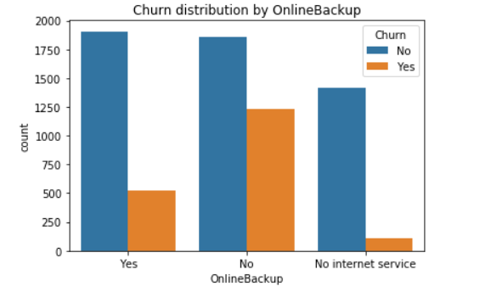
Service OnlineBackup
The customers who use online backup services churn less but we can see there is a little difference in the distribution of people with No Online Backup and people with Online Backup.

Slide 13
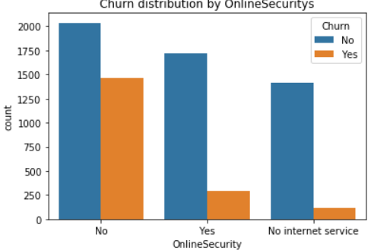
Service OnlineSecurity
Customers who not use the OnlineServices churn more than customers who use it.

Slide 14
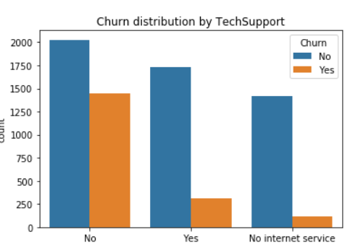
Service TechSupport
Customers who don’t use TechSupport churn less than customers who use it.

Slide 15
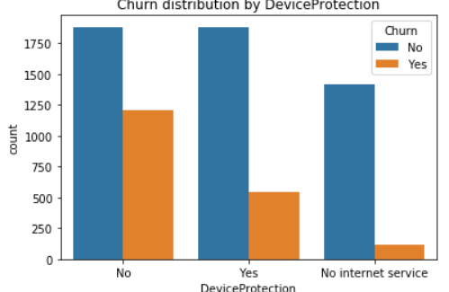
Service DeviceProtection
There is a little difference in the distribution between customers with DeviceProtection and customers with no Deviceprotection , but we can see customers with DeviceProtection churn less than customers with no DeviceProtection.

Slide 16
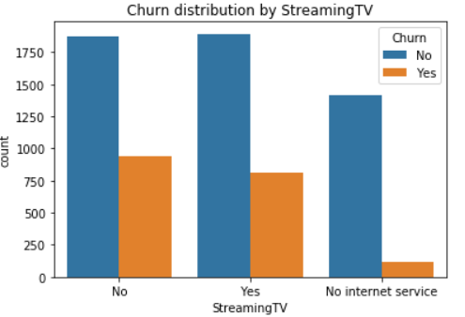
Service Streaming TV
Customers with no internet service churn less, but customers who not use streaming TV churn a little bit more than customers who use it .

Slide 17
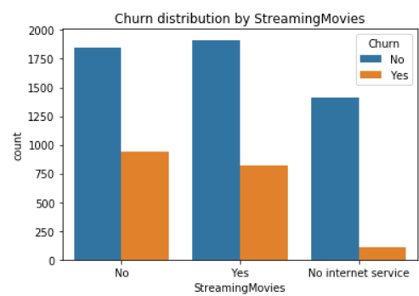
Service Streaming Movies
There it’s like the previous slide,customers with no internet service churn less, but customers who not use streaming Movies churn a little bit more than customers who use it .

Slide 18
DISTRIBUTION OF CHURN BY BILLING INFORMATION

Slide 19
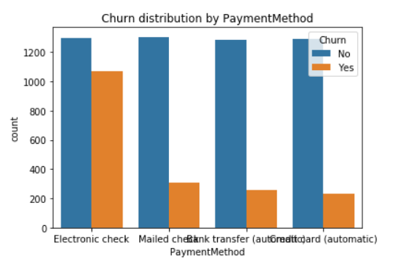
PaymentMethod
Customers with electronic check churn more.

Slide 20
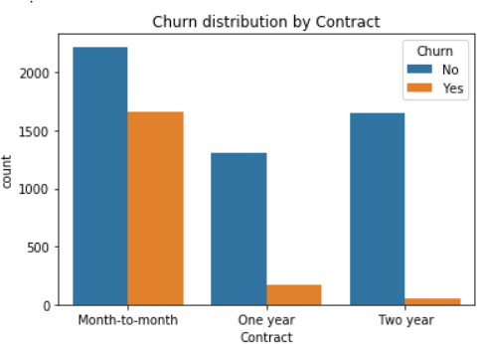
Contract
Customers with a month to month contract are those who churn more and we can see customers with one year contract churn a little bit more than the two years contract .

Slide 21
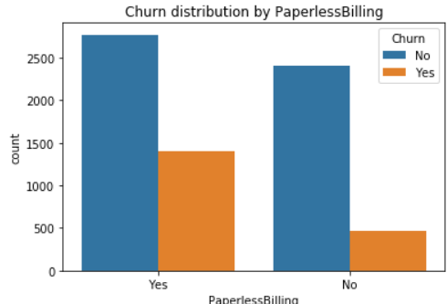
PaperlessBillinng
Customers who use the paperless billing churn more than customers who do not use it.

Slide 22
Bonus
The company's going to take about 29 months to lose all his clients.
They will lose the demographics independent first because they the will churn in 5 months(the codes are in the jupyter notebook).

Slide 23
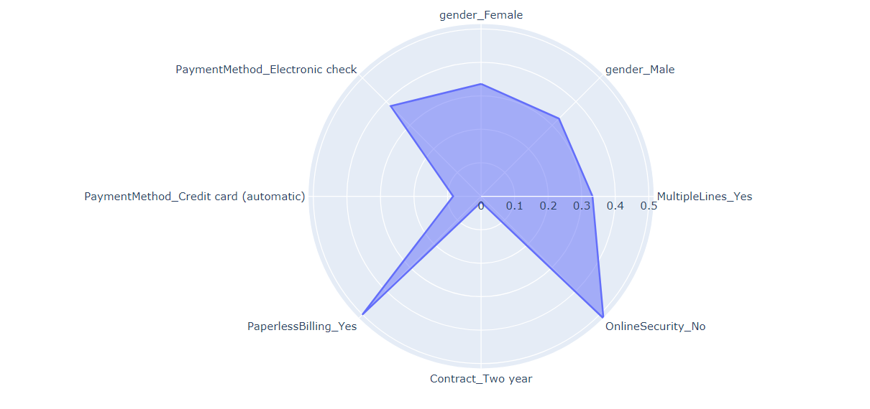
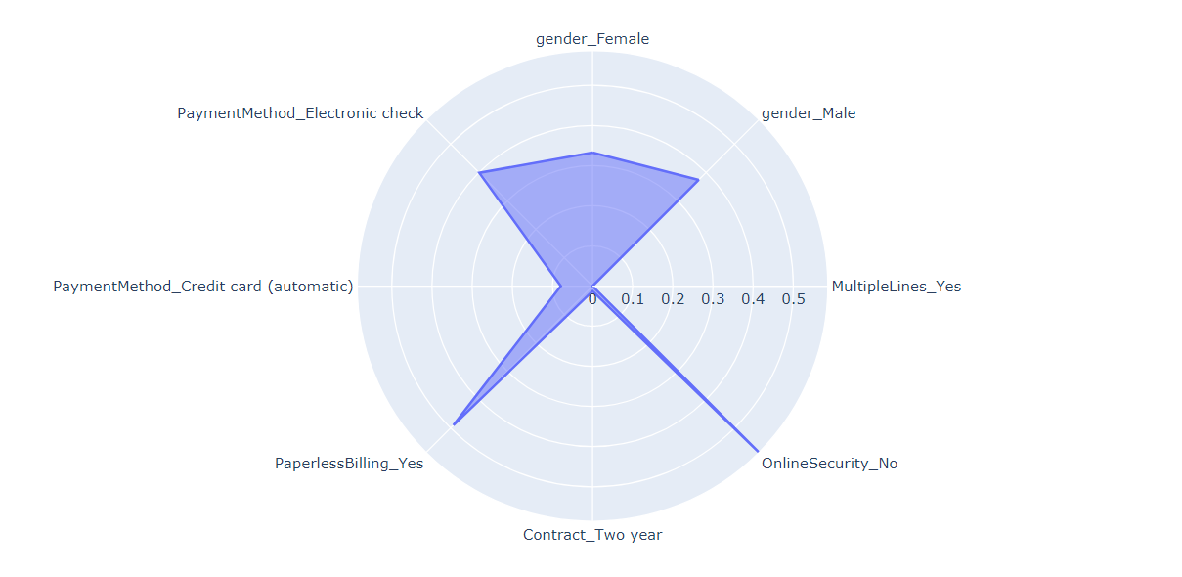
Radar Chart

Slide 24
Discussion & Recommendations
My proposed solution: In light of competition in the market, which is one of the main causes of the churn, after identifying other reasons why customers have left, the telecom company could innovate its services to make changes that will be much more responsive to customer requirements within the carrier to be able to satisfy them much more.

Slide 25
Discussion & Recommendations
What are strengths of the organization that you have leveraged in your solution?
The company has a certain renown in the market as it has been in existence for several years.
The company has a massive market share.
What are weaknesses of the organization that could undermine your solution?
It's difficult for the company to get new customers.
What are challenges that you might encounter? How can you mitigate them?
the customers can be a little reluctant despite we have proposed new services much more advantageous.
In this case we can generate within the marketing department to make advertising quite real and convincing.

Slide 26
References & Appendices
https://www.kaggle.com/blastchar/telco-customer-churn/data#
https://medium.com/@randerson112358/predict-customer-churn-using-python-machine-learning-b92f39685f4c
https://github.com/Chvava11/Bi_project_customer_churn

